Slide 1
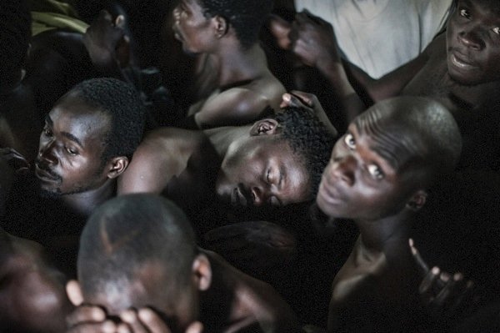
Lynette Mabote
AIDS and Rights Alliance for Southern Africa (ARASA)
‘Nothing about us without us’
Making prison reforms work holistically to effectively and appropriately address HIV

Slide 2
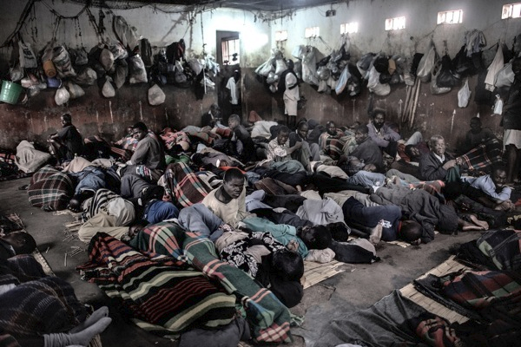
Places of Detention
OPCAT Article 4.1: [...] to any place under its jurisdiction and control where persons are or may be deprived of their liberty, either by virtue of an order given by a public authority or at its instigation or with its consent or acquiescence [...]

Slide 3
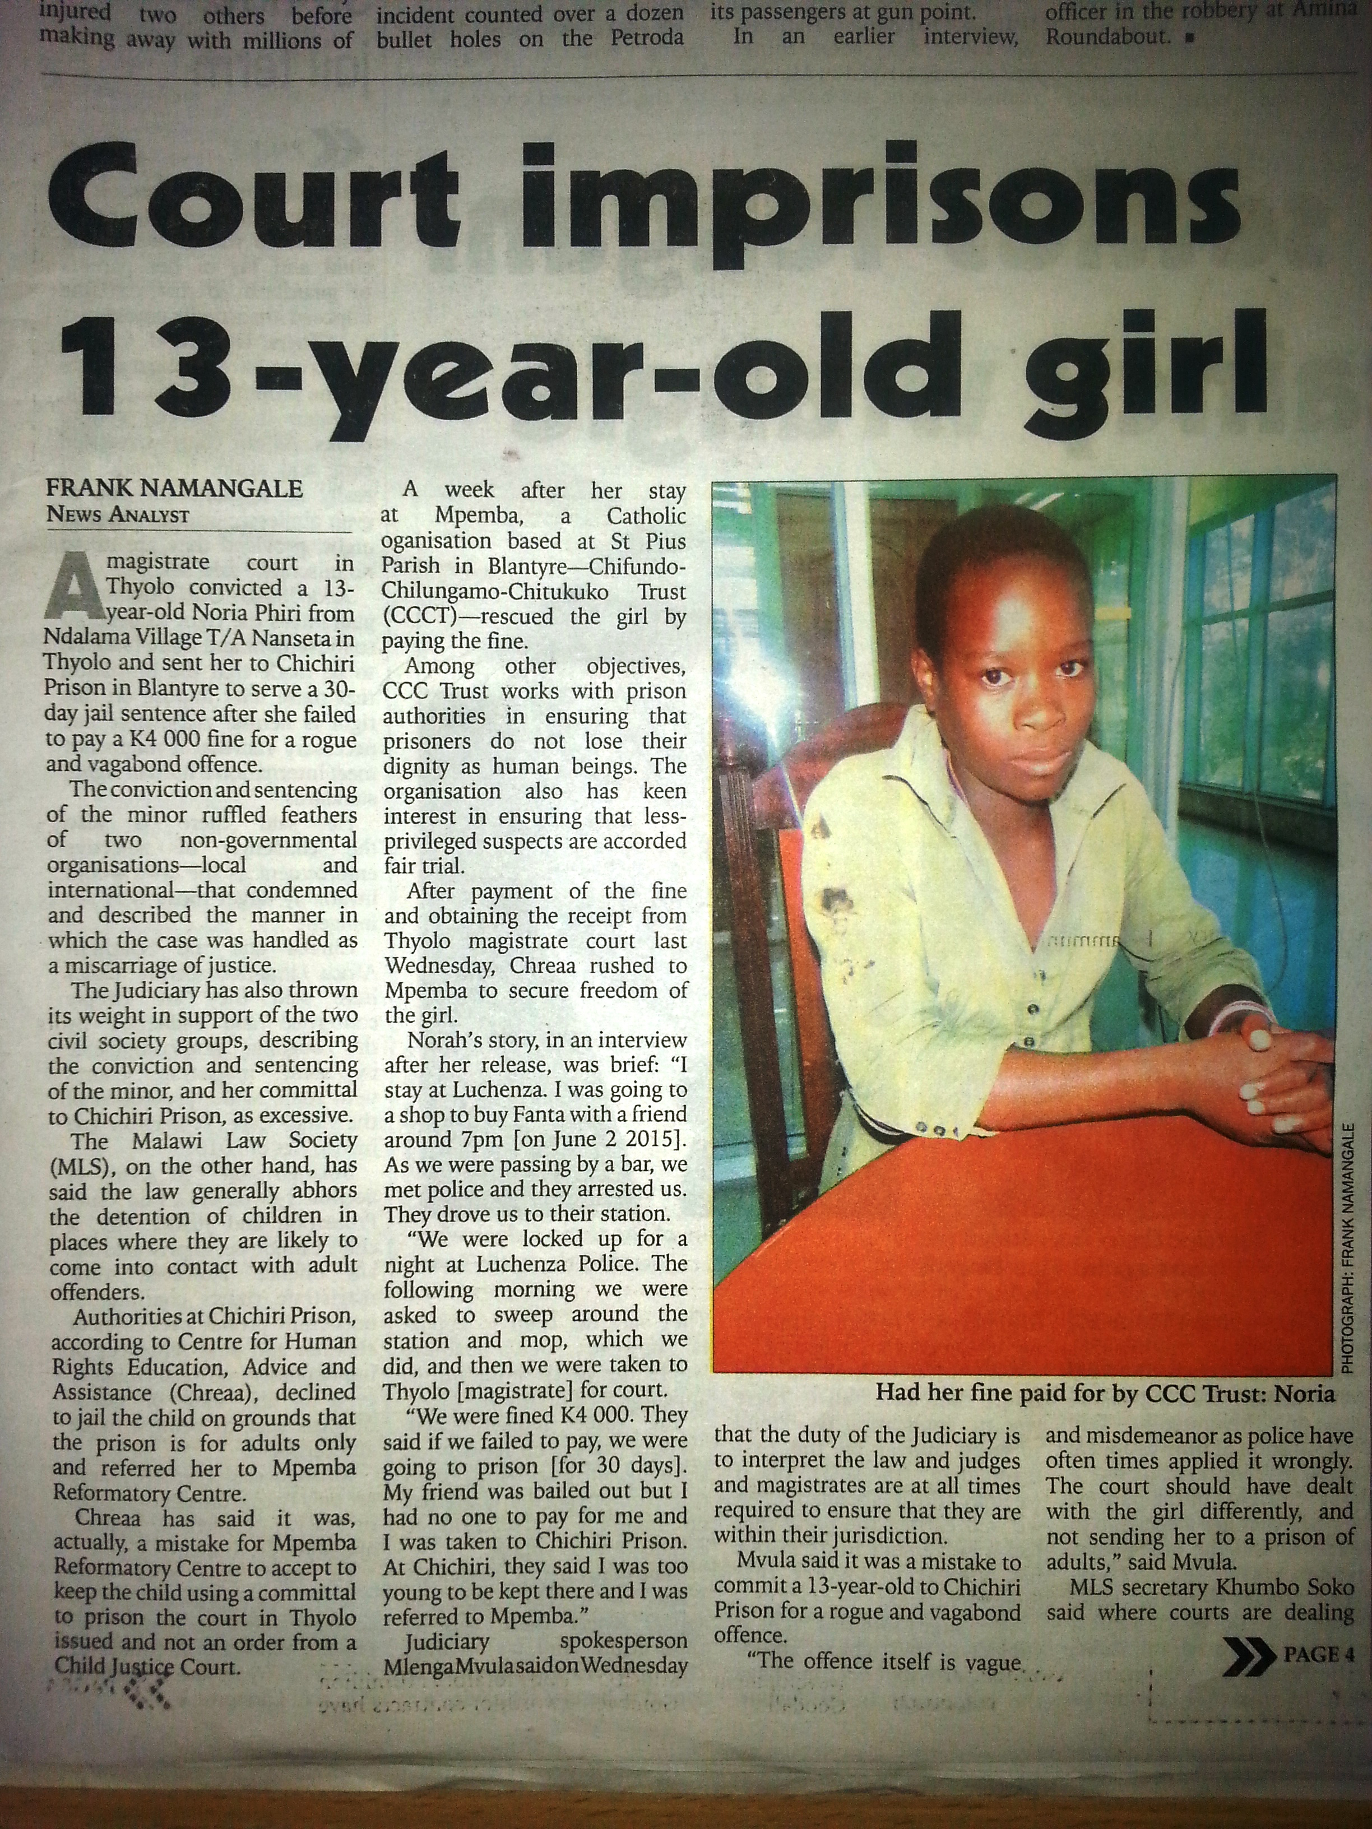
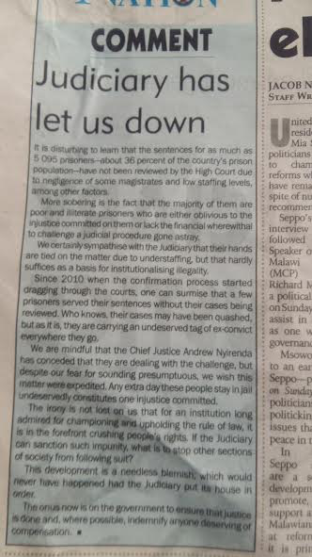
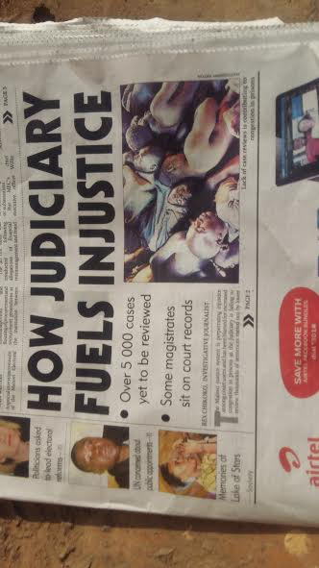
What is the story?

Slide 4

Is this a Public health Threat?
WHO and UNODC: Prevalence of HIV and TB 6 to 50 times higher inside African prisons than in the wider population
Cases of Tuberculosis (TB): Prisons may (conservatively) account for up to 25% of a country’s burden of TB
Breeding grounds for Multi-Drug Resistant TB (MDR-TB): Increasing levels of MDR-TB have been reported from some prisons, with up to 24% of TB cases suffering from multiple drug-resistant (MDR) forms of the TB disease.
Where are prisoners released to?
Notes:
http://www.who.int/tb/challenges/prisons/story_1/en/

Slide 5
Vulnerable groups in detention: “Othered others”
Women
Children
Physically disabled prisons
The mentally ill and those with intellectual disabilities
Persons with addictions
The elderly
Ethnic/religious minorities
The orphaned, the abandoned and the homeless
HIV positive persons
Those with other illnesses that require chronic care
Refugees, economic migrants, asylum seekers and internally displaced persons
Sexual minorities and transgendered (LGBTIQ+)
Sex workers
Victims of lifelong sexual, domestic or state-sanctioned violence

Slide 6
Women in prison as a vulnerable group
Data on women in prison in Africa almost impossible to secure
2017 World Prison Population List (WPPL) figures; Global female prison population increased by 20% since 2000
  The female prison population total has increased by a staggering 50%, compare to 18% for men since 2000
  700,000 women and girls are held in penal institutions throughout the world).

Slide 7
Case study: Republic of South Africa
Of 161,984 offenders, 4193 are women (about 4%)
5% increase from previous year (n=3915) and an 18% increase from three years earlier (n=3380 in 2012/13)
Women are most likely to be sentenced for offences that are ‘economically related’ (45%) – though this term is not defined anywhere
‘Aggressive crimes’ being second most prevalent type of offences for which women are incarcerated (38%).
There is no other official South African data on women in prison
Notes:
Dr. L. Artz, “HIV and Human Rights in Place of Detention” [October 2017], Gender, Health & Social Justice Research Unit, Faculty of Health Sciences, UCT ( Presentation Delivery at 2nd NHRI’s Meeting, Johannesburg October 2017)

Slide 8
Civil Society response:
Southern and East Africa
CASE STUDY: Centre for Human Rights Education, Advice and Assistance (CHREAA) based in Malawi
Involved in a project called “Increasing accountability and responsiveness of the Malawi Prison Service in the delivery of health services”
CHREAA lobbied Ministry of Finance to increase the health budget in prison with MK50,000,000 (about $68,800) for the year 2016-2017. This figure represented a 60% increase of the prison health budget for the past five years.
CHREAA is also a member of the Judiciary Core Group which was set up by the Chief Justice to work towards de-congesting the prisons in Malawi

Slide 9
CASE STUDY: UGANET, Uganda
Engaging policy makers on legal, health and HIV needs of prisoners
Increasing access to legal aid and human rights awareness raising for prisoners living with HIV.
Strengthening service systems to facilitate an enabling legal environment for an improved HIV and human rights response.
So far, 20 inmates (10 women 10 men) were identified, trained and equipped with basic legal and human rights skills.
Uganet Project in Uganda

Slide 10
People incarcerated for not adhering to their TB medicines in Kenya…
Petition 329 of 2014

Slide 11
African Commission’s Special Rapporteur on Prisons and Conditions of Detention in Africa (2012)
Simple Argument for Prisons’ Reform
Africa’s prison populations have risen by 71 per cent since 2009 meaning an escalating prison population that aggravates associated problems of overcrowding – central to innumerable problems – and depleted resources, leading to poor prison control, inadequate operation, and ongoing failure to protect inmates’ rights….Around 50% of prisoners are on remand, possibly for crimes as minor as stealing a pen knife or a chicken.
Whilst governments claim reform and rehabilitation as the aim of criminal justice, in practice, prison systems fail to deliver as expected and recent reports have shown that prison systems inmost African countries are in crisis, burdened with overcrowding and an inability to satisfy basic human rights standards, despite states’ ratification of regional and international protocols and conventions.

Slide 12
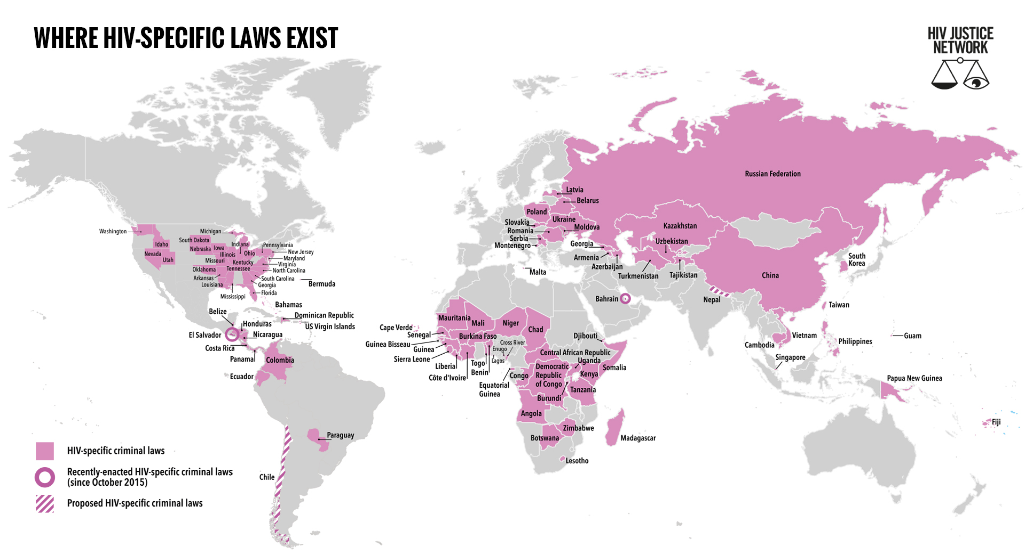
Case study: A global movement to end HIV criminalisation
Data correct as of 1st July 2018
Source: Bernard EJ and Cameron S. Global trends in HIV criminalisation: Overview, analysis and country ranking. TUPED512
Notes:
Note: DRC just repealed it’s HIV-specific law last week!

Slide 13
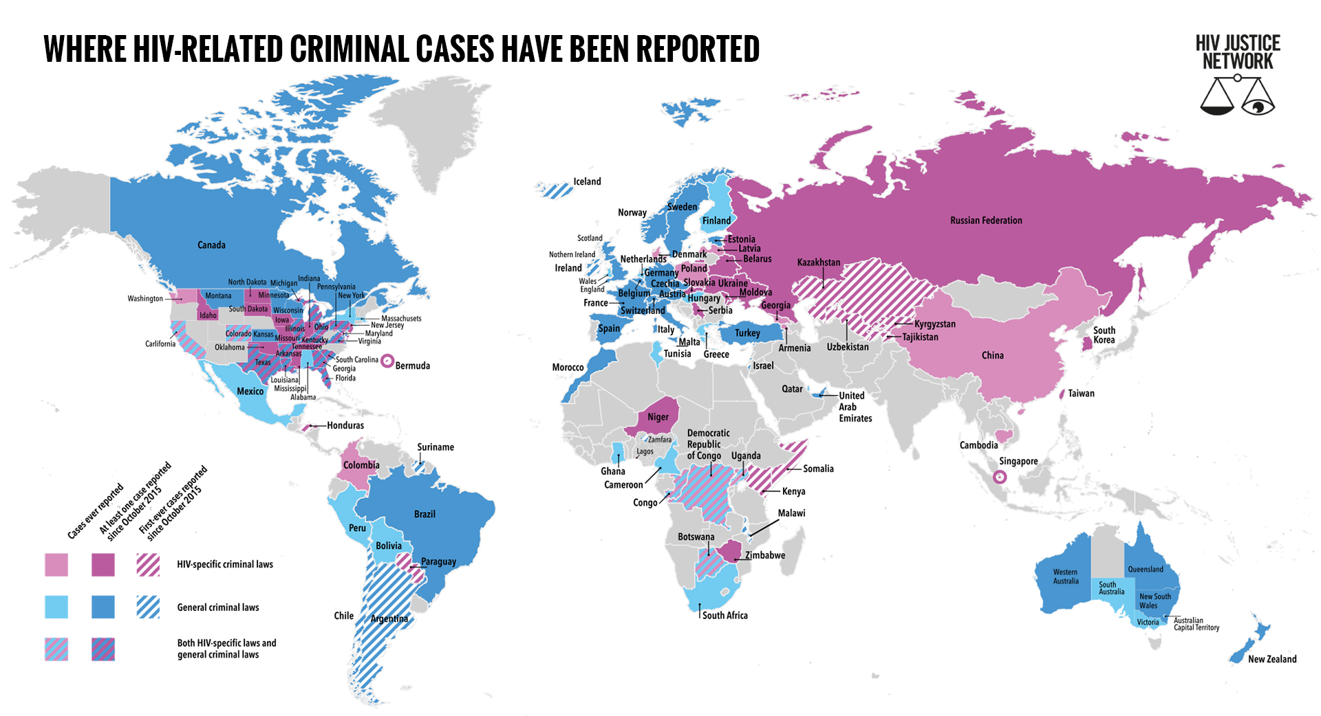
Data correct as of 1st July 2018
Source: Bernard EJ and Cameron S. Global trends in HIV criminalisation: Overview, analysis and country ranking. TUPED512

Slide 14
“It is said that no one truly knows a nation until one has been inside its jails. A nation should not be judged by how it treats its highest citizens, but its lowest ones.”
Nelson Mandela

Slide 15
Thank you
Lynette Mabote
Southern and East Africa Regional Programmes Lead
AIDS and Rights Alliance for Southern Africa (ARASA)
Mobile: +27 81 550 8558
Email: lynette@arasa.info
Skype:Lynette.Mabote
Twitter:@_ARASAcomms
Web: www.arasa.info

